Slide 1
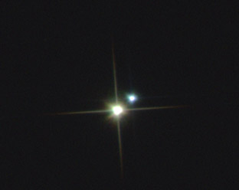
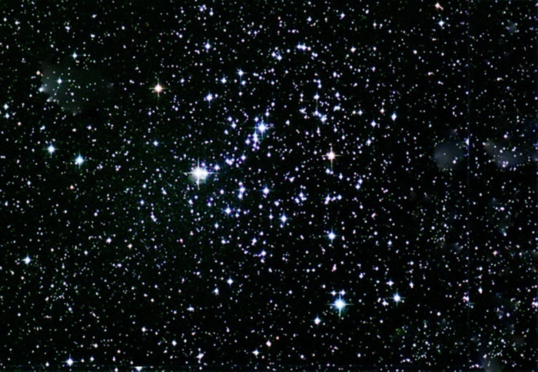
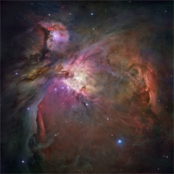

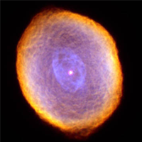

Slide 2
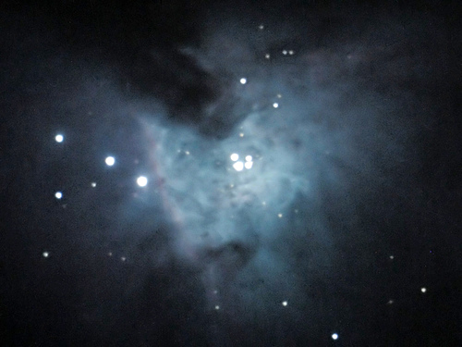
Orion Nebula (M42)
Through the Telescope

Slide 3
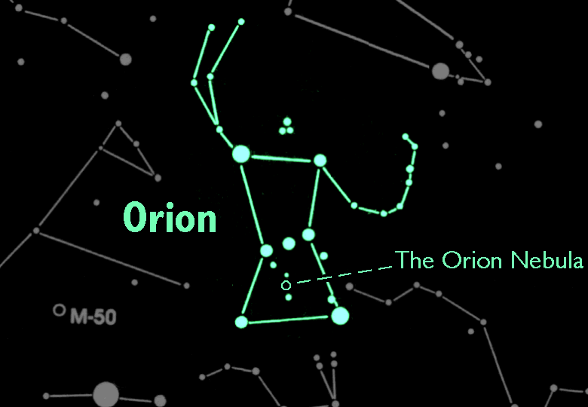
Orion Nebula (M42)
In the Night Sky
M42 is the second 'star' in the sword of Orion the Hunter.

Slide 4
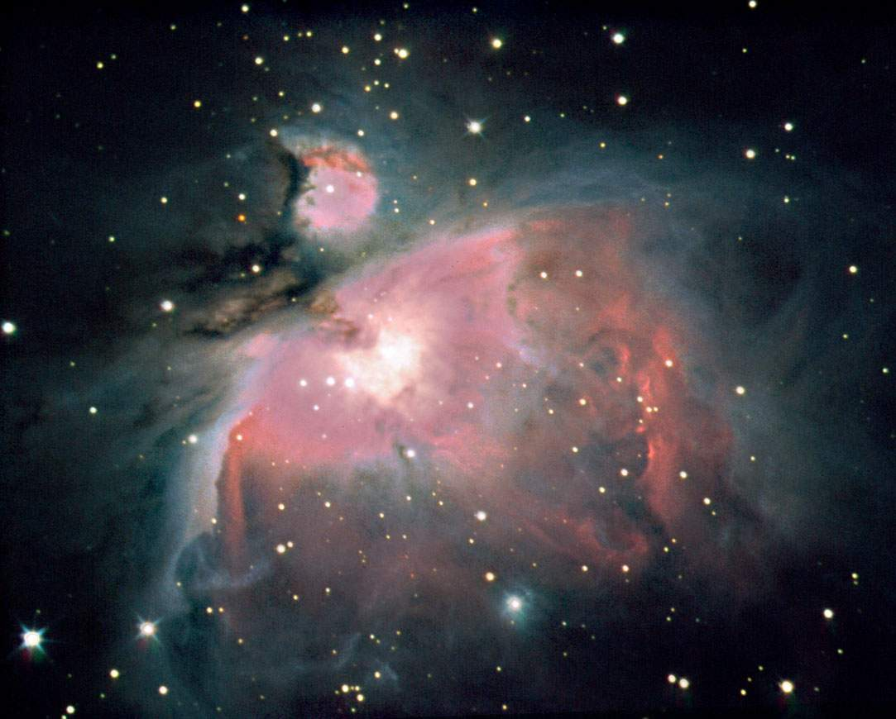
Diffuse Nebulae
M42 is an example of a diffuse nebula - a cloud of gas and dust in which stars are being born.

Slide 5
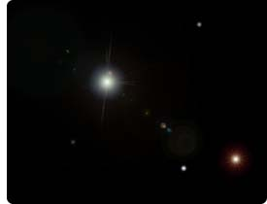
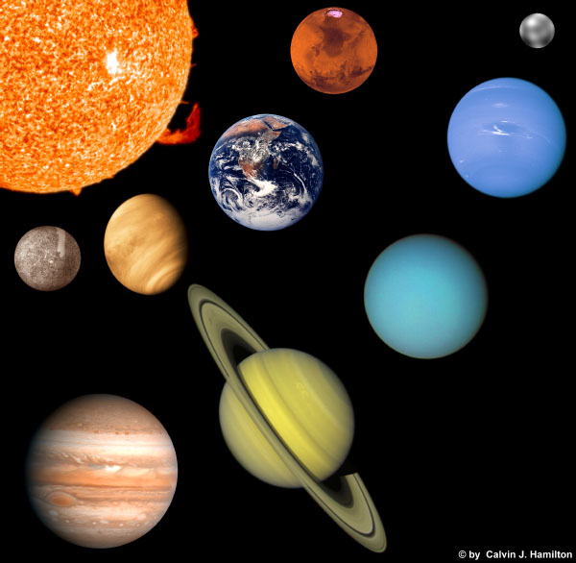

Diffuse Nebulae
The density of the nebula is a better vacuum than any vacuum we can create here on Earth.
A piece of the nebula the size of the earth has only enough material to fit in a thimble.

Slide 6
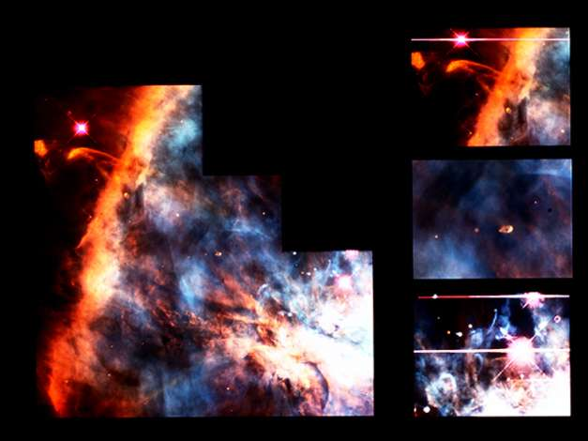
Diffuse Nebulae
Over the course of a few hundred thousand or million years, the cloud will break up into 100-200 smaller clouds, each of which will eventually condense into young proto-stars.

Slide 7
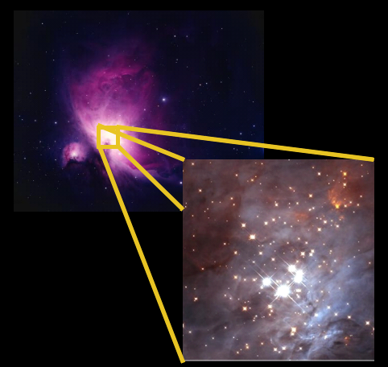
The Trapezium
Within the Orion Nebula there are over 1,500 young stars, dominated by the four brightest.
These stars, called the ‘Trapezium’, illuminate the rest of the nebula making it visible to us.

Slide 8
The Trapezium
The Intense radiation from the young hot stars is blowing the colder clouds of hydrogen away.
This process is called photoevaporation.

Slide 9
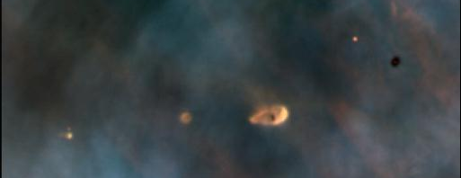
Young Star Formation
This Hubble Space Telescope image of a small portion of the Orion Nebula reveals five young stars surrounded by gas and dust trapped in orbit as they formed.

Slide 10
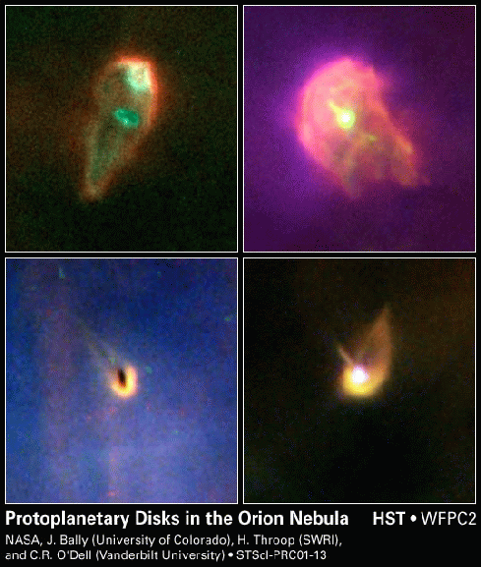
Stellar Disks
Flattened ovals can be seen in diffuse nebulae. They are thought to be a new solar systems forming around young stars.
They are called "protoplanetary disks"

Slide 11
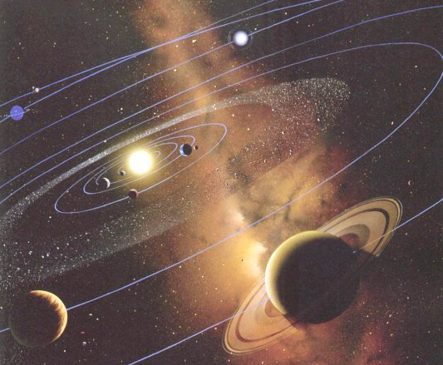
Solar Systems
Eventually, these protoplanetary disks will become solar systems, some may even become similar to our own.

Slide 12
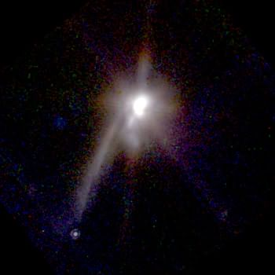
Binary Star and Planet Formation
In 1998, the Hubble Space Telescope observed this process in a new binary star system. It has a lane of dust pointing to a new Jupiter-sized planet.
In millions of years the dust will collapse into additional smaller planets or fall into the stars.
New proto-planet

Slide 13
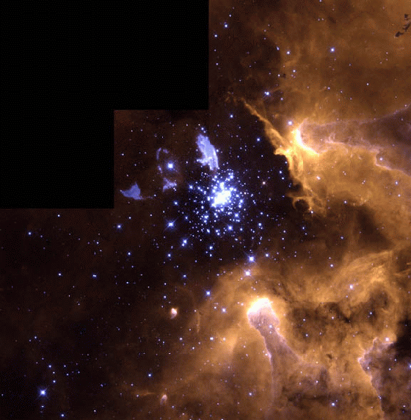
Star Clusters
This HST image shows a new star cluster emerging from a nebula.

Slide 14
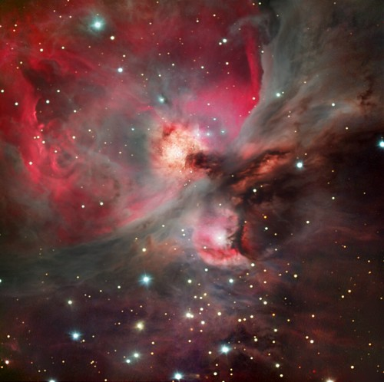
Our sun formed out of a nebula similar to M42 about 5 billion years ago.
Birth of a Star

